Slide 1
Epigenomics Websites and Bioinformatics

Slide 2


Introduction
Associate Bioinformatics Scientist at Coriell Institute for Medical Research
Help other people with their data analysis
Independent data analysis
All materials for my lecture will be online at
Notes:
Ask about background:
Has anyone done RNA-seq either made a library or analyzed it?

Slide 3
Where is the data?

Slide 4
Databases
Reference Information
Publicly Available Data
Variants
1000 Genomes https://www.internationalgenome.org/
ClinVar https://www.ncbi.nlm.nih.gov/clinvar/
Catalogue of Somatic Mutations in Cancer (COSMIC) https://cancer.sanger.ac.uk/cosmic
Epigenetics
Encyclopedia of DNA Elements (ENCODE) https://www.encodeproject.org/
Roadmap Epigenomics Project http://www.roadmapepigenomics.org/
Single Cell (everything is under active development)
Human Cell Atlas https://www.humancellatlas.org/
Mouse Cell Atlas http://bis.zju.edu.cn/MCA/
Tabula Muris https://tabula-muris.ds.czbiohub.org/
dbGaP https://www.ncbi.nlm.nih.gov/gap/
The Cancer Genome Atlas (TCGA) https://www.cancer.gov/about-nci/organization/ccg/research/structural-genomics/tcga
DeepBlue https://deepblue.mpi-inf.mpg.de/
NCBI Data
Gene Expression Omnibus (GEO) for processed data https://www.ncbi.nlm.nih.gov/geo/
Short Read Archive (SRA) for raw data https://www.ncbi.nlm.nih.gov/sra

Slide 5
DATABASE DEMO

Slide 6
General Genomics Analysis

Slide 7
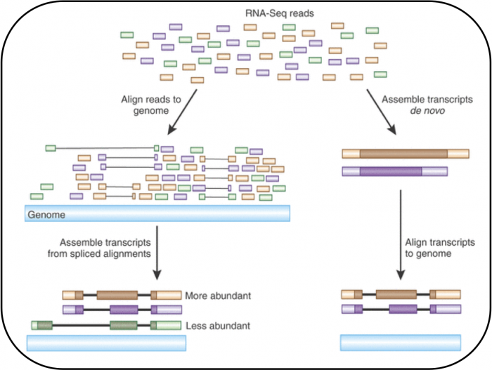
Process Data
Good Reads
Quality Control
Alignment
Count Features of Interest
Align
Count Reads
Notes:
Mapping reads to a reference or de novo assembly. Reprinted by permission on EMBL-EBI (https://www.ebi.ac.uk/training/online/course/functional-genomics-ii-common-technologies-and-data-analysis-methods/read-mapping-or) from Macmillan Publishers Ltd: Nature Biotechnology. Haas BJ and Zody MC. Advancing RNA-seq analysis. 28:421-423, copyright 2010 (10).

Slide 8
Analyze Data
Normalize
Normalize Data
Explore Data
Filter / Transform
Visualize
Model / Test
Communicate
Poster
Paper
Thesis
Blog post
New Project
Filter / Transform
Model / Test
Visualize
Communicate

Slide 9
DO A BIT OF ANALYSIS
https://infinityloop.shinyapps.io/TCC-GUI/

Slide 10
What Are the Variations When Looking at Different Features?

Slide 11
DNA-seq
Analyzes DNA sequence
Detect
Small nucleotide variants
Insertions and deletions
Copy number alterations
What variants are present in treatment that aren’t in my control?
Tests
Differential analysis
Disease vs non-diseases
Cancer vs normal in the same individual
Genome wide association study
Parent-child trios
Population genetics
Visualize
Manhattan plot
Image: Yang 2015, More Info: Mills 2019

Slide 12
Image: Yang 2015

Slide 13
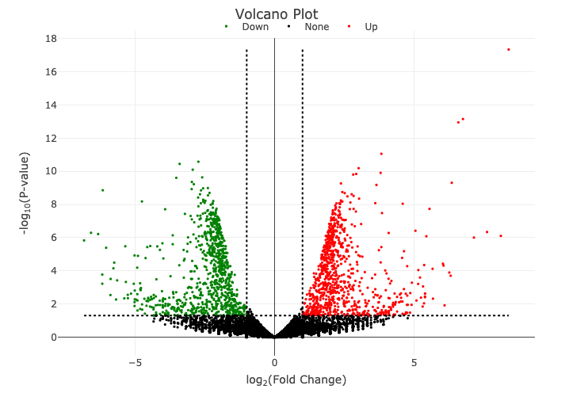
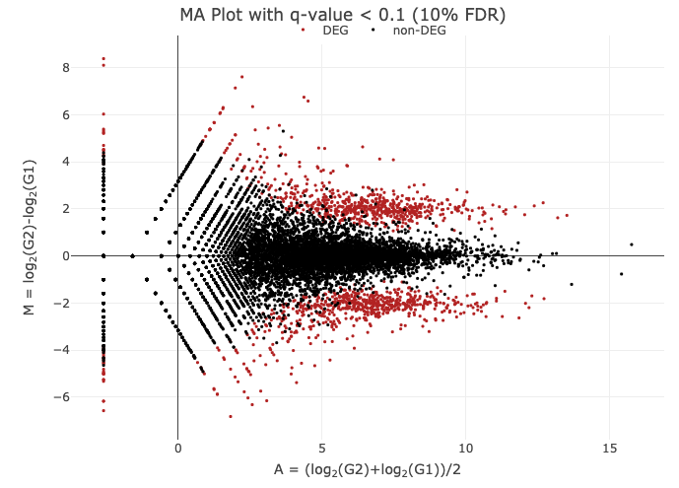
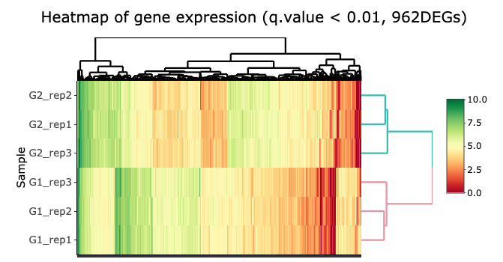
RNA-seq
Analyzes gene expression levels
Differential Expression: What is the relative change in expression between my conditions?
Visualize
Volcano plot
MA plot
heatmap
Images: TTC-GUI, More Info: Stark 2019

Slide 14
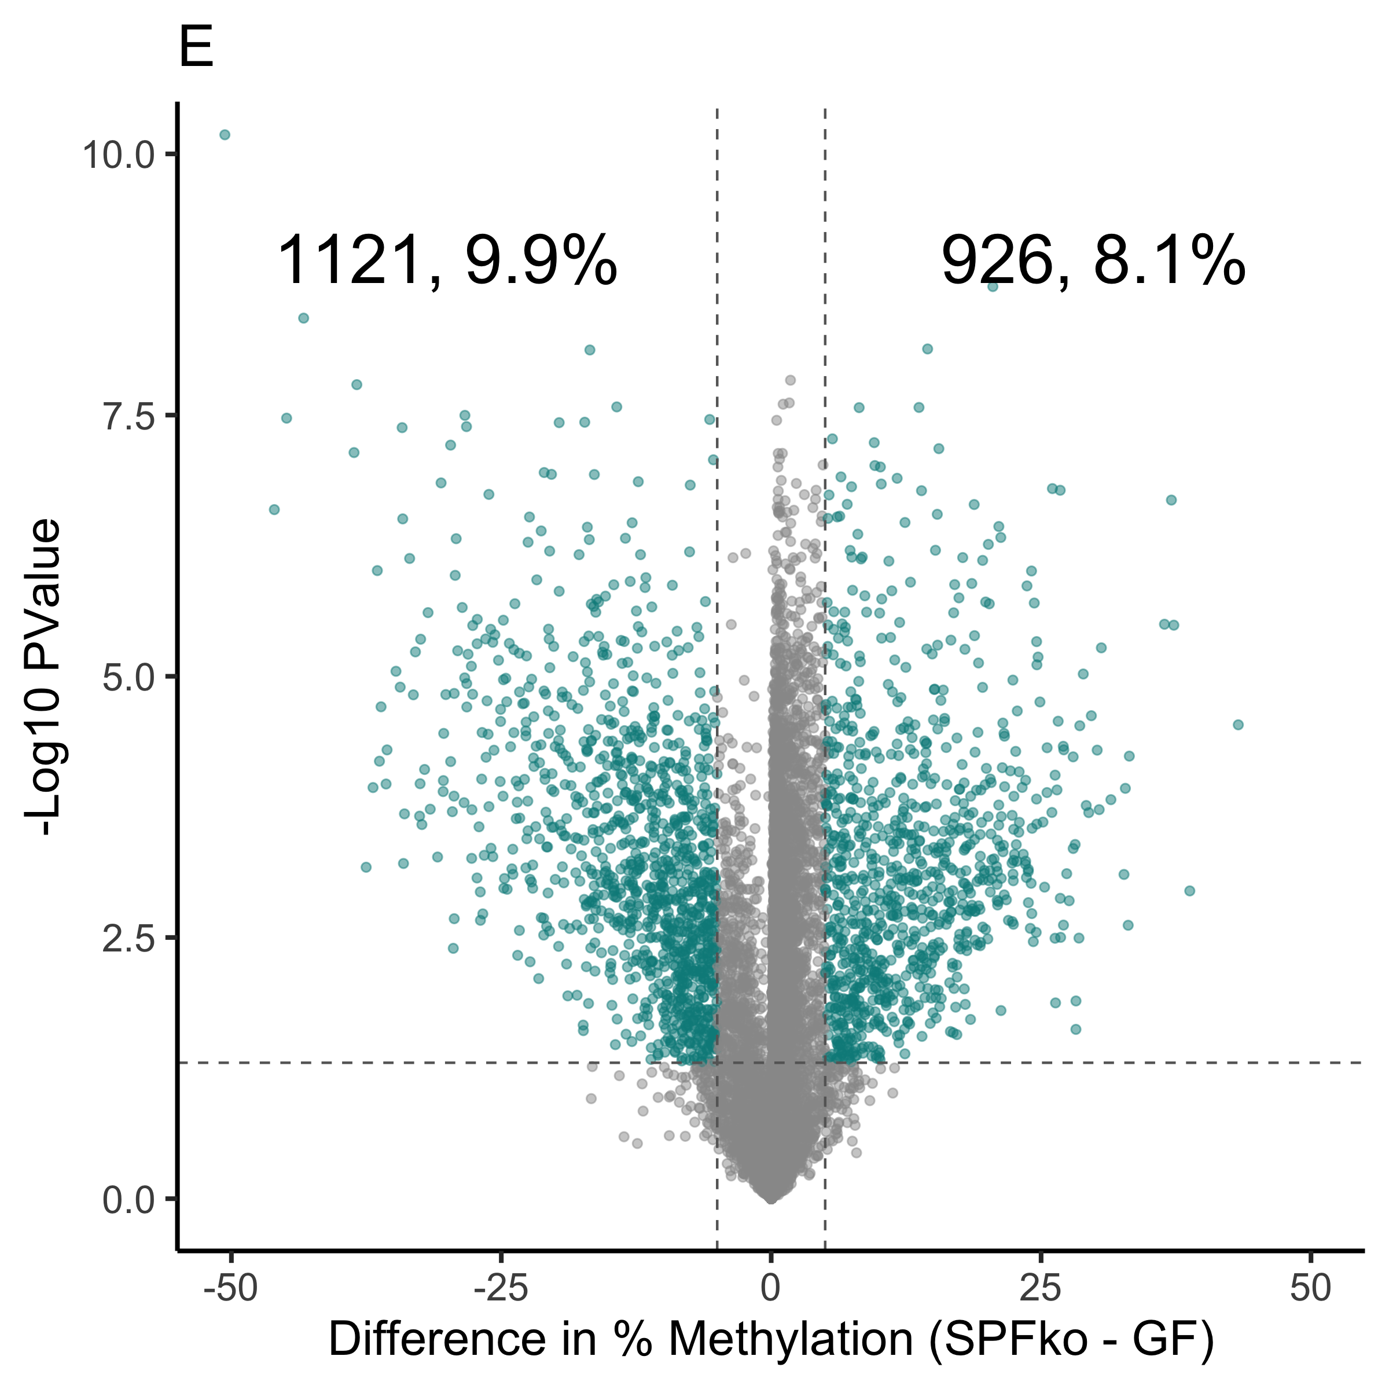
BS-seq
Analyzes gene methylation levels
Assays
Reduced Representation Bisulfite Sequencing (RRBS)
Whole Genome Bisulfite Sequencing (WGBS)
Differential Methylation: Which CpG sites changed methylation between my conditions?
Visualize
Volcano plot
Image: KK (unpublished), More Info: Barros-Silva 2018
Notes:
The volcano plot is from an unpublished manuscript from work.

Slide 15
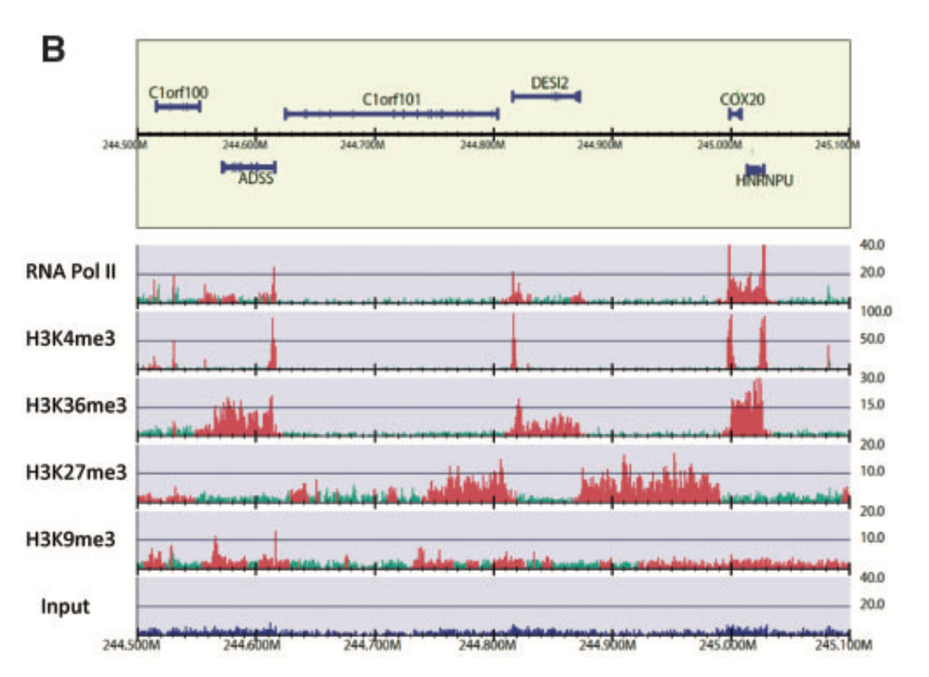
ChIP-seq
Analyzes features associated with DNA by targeting with an antibody against the feature of interest
DNA-associated proteins
Histone modifications
Instead of counting reads, call peaks
Where is my feature of interest? Does the location change or the signal change with the experimental condition?
Visualize
Example pileup
Traces
Heatmaps
Images: KK (unpublished), Nakato 2017, More Info: Nakato 2017

Slide 16
Images: KK (unpublished), Nakato 2017, More Info: Nakato 2017

Slide 17
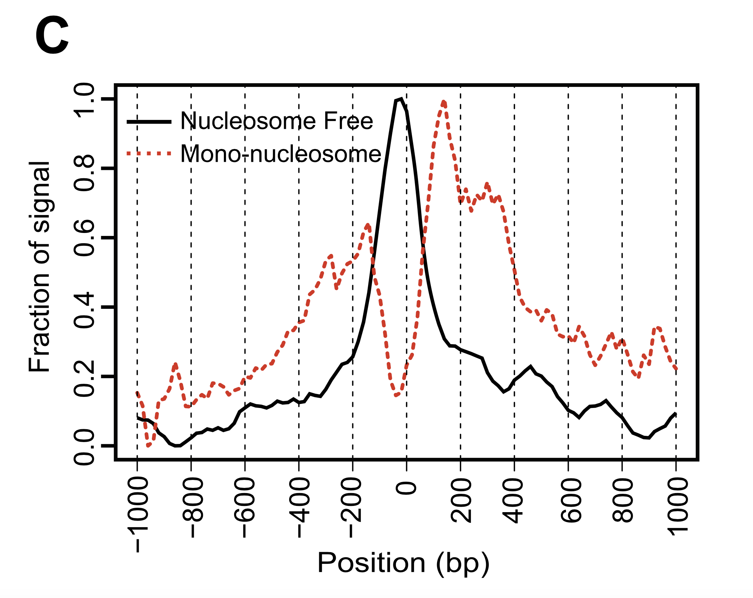
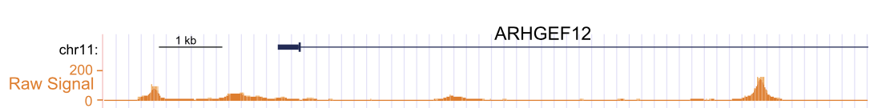
ATAC-seq
Assay for chromatin accessibility
Get signal in open chromatin
Most chromatin is closed, get well-defined signal in promoters and enhancers
Instead of counting reads, call peaks
Does the location change or the signal change with the experimental condition?
Visualize
Example pileup
Traces
Heatmaps
Images: Yan 2020, More Info: Yan 2020

Slide 18
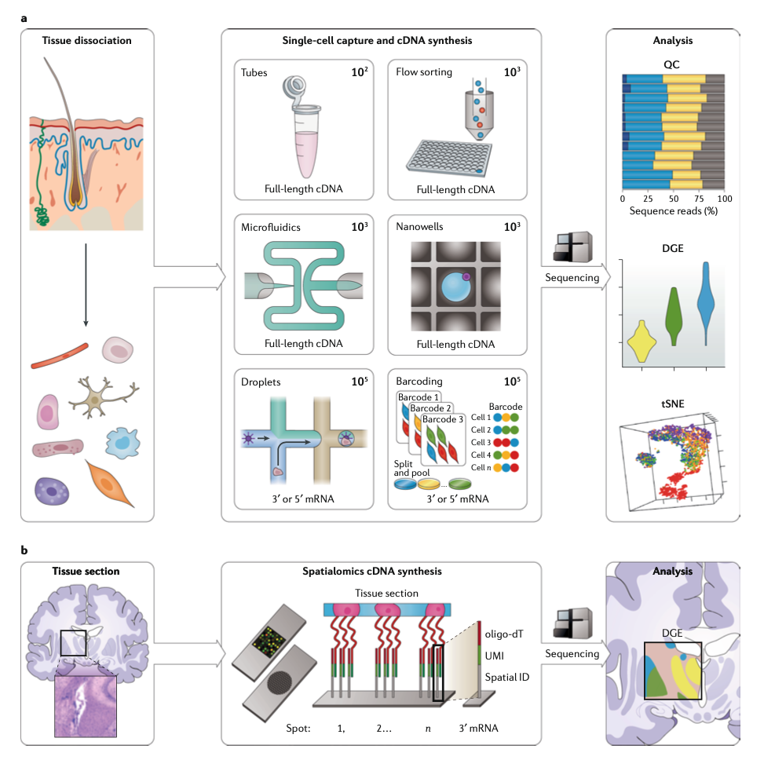
Single Cell Assays
Images: Stark 2019, More Info: Stark 2019, Lahneman 2020

Slide 19
How to can I get started in bioinformatics on my own? (A collection of free online resources)
Learn a scripting language
R https://r4ds.had.co.nz/
Python https://jakevdp.github.io/PythonDataScienceHandbook/
Take a work through a genomics, biostatistics, and/or bioinformatics course
Biomedical Data Science http://genomicsclass.github.io/book/
Modern Statistics for Modern Biology http://web.stanford.edu/class/bios221/book/index.html
Bioinformatics Data Skills https://vincebuffalo.com/book/ (book not free sorry!)
Go to a MeetUp
RLadies Philly https://www.meetup.com/rladies-philly/
Philadelphia Python Users Group https://vincebuffalo.com/book/

Slide 20
References
Literature:
DNA-seq: Mills, M. C. & Rahal, C. A scientometric review of genome-wide association studies. Communications Biology 2, (2019).
RNA-seq: Stark, R., Grzelak, M. & Hadfield, J. RNA sequencing: the teenage years. Nat Rev Genet 20, 631–656 (2019). https://doi.org/10.1038/s41576-019-0150-2
BS-seq: Yan, F., Powell, D. R., Curtis, D. J. & Wong, N. C. From reads to insight: a hitchhiker’s guide to ATAC-seq data analysis. Genome Biology 21, (2020).
ChIP-seq: Nakato, R. & Shirahige, K. Recent advances in ChIP-seq analysis: from quality management to whole-genome annotation. Briefings in Bioinformatics bbw023 (2016) doi:10.1093/bib/bbw023.
ATAC-seq: Yan, F., Powell, D. R., Curtis, D. J. & Wong, N. C. From reads to insight: a hitchhiker’s guide to ATAC-seq data analysis. Genome Biology 21, (2020).
Single Cell: Lähnemann, D. et al. Eleven grand challenges in single-cell data science. Genome Biology 21, (2020).
Images:
Mapping reads to a reference or de novo assembly. Reprinted by permission on EMBL-EBI (https://www.ebi.ac.uk/training/online/course/functional-genomics-ii-common-technologies-and-data-analysis-methods/read-mapping-or) from Macmillan Publishers Ltd: Nature Biotechnology. Haas BJ and Zody MC. Advancing RNA-seq analysis. 28:421-423, copyright 2010 (10).
Yang, Xiaobo; Sun, Jielin; Gao, Yong; Tan, Aihua; Zhang, Haiying; Hu, Yanling; et al. (2015): Manhattan plot of genome-wide association analyses for C3 level.. PLOS Genetics. Figure. https://doi.org/10.1371/journal.pgen.1002916.g001

